Slide 1
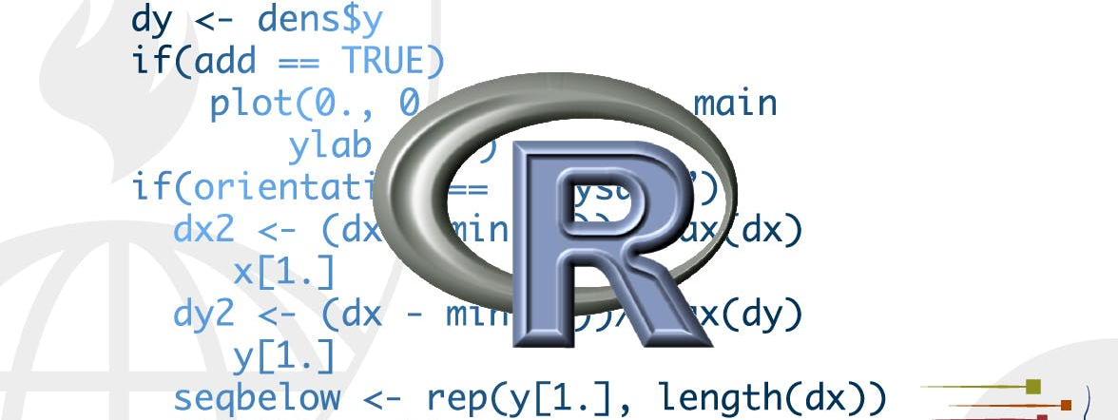
Dates and times
STA 4233 Introduction to Programming and Data Management in R
Notes:
This lecture will show you how to work with dates and times in R. At first glance, dates and times seem simple. You use them all the time in your regular life, and they don’t seem to cause much confusion. However, the more you learn about dates and times, the more complicated they seem to get. To warm up, try these three seemingly simple questions:
Does every year have 365 days?
Does every day have 24 hours?
Does every minute have 60 seconds?
I’m sure you know that not every year has 365 days, but do you know the full rule for determining if a year is a leap year? (It has three parts.) You might have remembered that many parts of the world use daylight savings time (DST), so that some days have 23 hours, and others have 25. You might not have known that some minutes have 61 seconds because every now and then leap seconds are added because the Earth’s rotation is gradually slowing down.
Dates and times are hard because they have to reconcile two physical phenomena (the rotation of the Earth and its orbit around the sun) with a whole raft of geopolitical phenomena including months, time zones, and DST. This lecture won’t teach you every last detail about dates and times, but it will give you a solid grounding of practical skills that will help you with common data analysis challenges.

Slide 2

the lubridate package
library(tidyverse)
library(lubridate)
library(nycflights13)
Notes:
This lecture will focus on the lubridate package, which makes it easier to work with dates and times in R. lubridate is not part of core tidyverse because you only need it when you’re working with dates/times. We will also need nycflights13 for practice data.

Slide 3
Creating date/times
A date. Tibbles print this as <date>.
A time within a day. Tibbles print this as <time>.
A date-time is a date plus a time: it uniquely identifies an instant in time (typically to the nearest second). Tibbles print this as <dttm>. Elsewhere in R these are called POSIXct, but I don’t think that’s a very useful name.
Notes:
There are three types of date/time data that refer to an instant in time:
A date. Tibbles print this as <date>.
A time within a day. Tibbles print this as <time>.
A date-time is a date plus a time: it uniquely identifies an instant in time (typically to the nearest second). Tibbles print this as <dttm>. Elsewhere in R these are called POSIXct, but I don’t think that’s a very useful name.
In this lecture we are only going to focus on dates and date-times as R doesn’t have a native class for storing times. If you need one, you can use the hms package.

Slide 4
Creating date/times
today()
#> [1] "2020-01-15"
now()
#> [1] "2020-01-15 18:47:27 UTC"
Notes:
You should always use the simplest possible data type that works for your needs. That means if you can use a date instead of a date-time, you should. Date-times are substantially more complicated because of the need to handle time zones, which we’ll come back to at the end of the lecture.
To get the current date or date-time you can use today() or now():

Slide 5
Creating date/times
From a string.
From individual date-time components.
From an existing date/time object.
Notes:
Otherwise, there are three ways you’re likely to create a date/time:
From a string.
From individual date-time components.
From an existing date/time object.
They work as follows.

Slide 6
From strings
ymd("2017-01-31")
#> [1] "2017-01-31"
mdy("January 31st, 2017")
#> [1] "2017-01-31"
dmy("31-Jan-2017")
#> [1] "2017-01-31"
ymd(20170131)
#> [1] "2017-01-31"
Notes:
Date/time data often comes as strings. You’ve seen one approach to parsing strings into date-times in date-times. Another approach is to use the helpers provided by lubridate. They automatically work out the format once you specify the order of the component. To use them, identify the order in which year, month, and day appear in your dates, then arrange “y”, “m”, and “d” in the same order. That gives you the name of the lubridate function that will parse your date. For example:
These functions also take unquoted numbers. This is the most concise way to create a single date/time object, as you might need when filtering date/time data. ymd() is short and unambiguous:

Slide 7
Ymd and friends
ymd_hms("2017-01-31 20:11:59")
#> [1] "2017-01-31 20:11:59 UTC"
mdy_hm("01/31/2017 08:01")
#> [1] "2017-01-31 08:01:00 UTC"
ymd(20170131, tz = "UTC")
#> [1] "2017-01-31 UTC"
Notes:
ymd() and friends create dates. To create a date-time, add an underscore and one or more of “h”, “m”, and “s” to the name of the parsing function:
You can also force the creation of a date-time from a date by supplying a timezone:

Slide 8
From individual components
flights %>%
select(year, month, day, hour, minute)
#> # A tibble: 336,776 x 5
#> year month day hour minute
#> <int> <int> <int> <dbl> <dbl>
#> 1 2013 1 1 5 15
#> 2 2013 1 1 5 29
#> 3 2013 1 1 5 40
#> 4 2013 1 1 5 45
#> 5 2013 1 1 6 0
#> 6 2013 1 1 5 58
#> # … with 3.368e+05 more rows
Notes:
Instead of a single string, sometimes you’ll have the individual components of the date-time spread across multiple columns. This is what we have in the flights data:

Slide 9
Make_date() and make_datetime()
flights %>%
select(year, month, day, hour, minute) %>%
mutate(departure = make_datetime(year, month, day, hour, minute))
#> # A tibble: 336,776 x 6
#> year month day hour minute departure
#> <int> <int> <int> <dbl> <dbl> <dttm>
#> 1 2013 1 1 5 15 2013-01-01 05:15:00
#> 2 2013 1 1 5 29 2013-01-01 05:29:00
#> 3 2013 1 1 5 40 2013-01-01 05:40:00
#> 4 2013 1 1 5 45 2013-01-01 05:45:00
#> 5 2013 1 1 6 0 2013-01-01 06:00:00
#> 6 2013 1 1 5 58 2013-01-01 05:58:00
#> # … with 3.368e+05 more rows
Notes:
To create a date/time from this sort of input, use make_date() for dates, or make_datetime() for date-times:

Slide 10
Creating date/times From individual components
make_datetime_100 <- function(year, month, day, time) {
make_datetime(year, month, day, time %/% 100, time %% 100)
}
flights_dt <- flights %>%
filter(!is.na(dep_time), !is.na(arr_time)) %>%
mutate(
dep_time = make_datetime_100(year, month, day, dep_time),
arr_time = make_datetime_100(year, month, day, arr_time),
sched_dep_time = make_datetime_100(year, month, day, sched_dep_time),
sched_arr_time = make_datetime_100(year, month, day, sched_arr_time) ) %>%
select(origin, dest, ends_with("delay"), ends_with("time"))
Notes:
Let’s do the same thing for each of the four time columns in flights. The times are represented in a slightly odd format, so we use modulus arithmetic to pull out the hour and minute components. Once I’ve created the date-time variables, I focus in on the variables we’ll explore in the rest of the lecture.

Slide 11
Creating date/times From individual components
flights_dt
#> # A tibble: 328,063 x 9
#> origin dest dep_delay arr_delay dep_time sched_dep_time
#> <chr> <chr> <dbl> <dbl> <dttm> <dttm>
#> 1 EWR IAH 2 11 2013-01-01 05:17:00 2013-01-01 05:15:00
#> 2 LGA IAH 4 20 2013-01-01 05:33:00 2013-01-01 05:29:00
#> 3 JFK MIA 2 33 2013-01-01 05:42:00 2013-01-01 05:40:00
#> 4 JFK BQN -1 -18 2013-01-01 05:44:00 2013-01-01 05:45:00
#> 5 LGA ATL -6 -25 2013-01-01 05:54:00 2013-01-01 06:00:00
#> 6 EWR ORD -4 12 2013-01-01 05:54:00 2013-01-01 05:58:00
#> # … with 3.281e+05 more rows, and 3 more variables: arr_time <dttm>,
#> # sched_arr_time <dttm>, air_time <dbl>
Notes:
Let’s do the same thing for each of the four time columns in flights. The times are represented in a slightly odd format, so we use modulus arithmetic to pull out the hour and minute components. Once I’ve created the date-time variables, I focus in on the variables we’ll explore in the rest of the lecture.

Slide 12
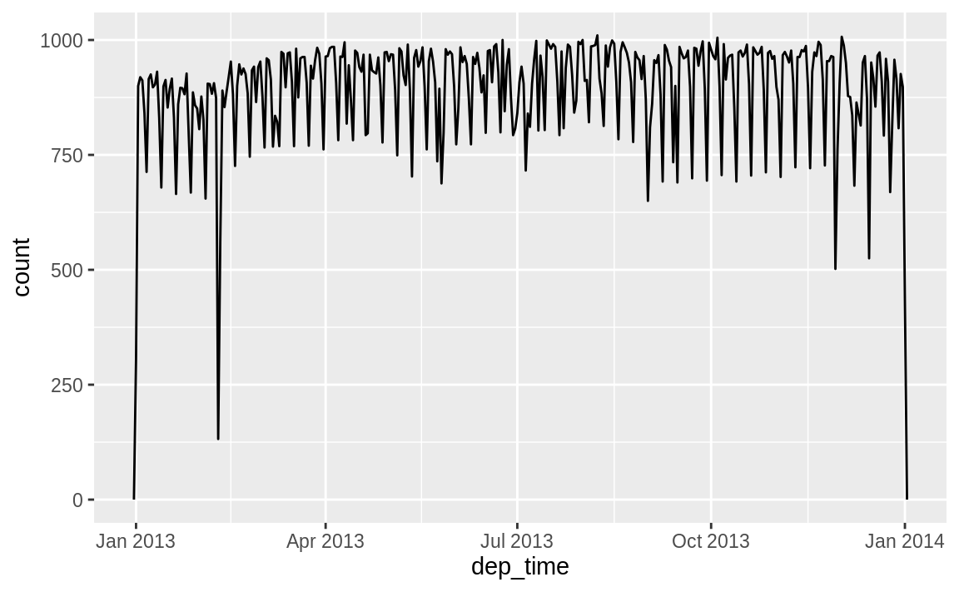
departure times across the year
flights_dt %>% ggplot(aes(dep_time)) +
geom_freqpoly(binwidth = 86400) # 86400 seconds = 1 day
Notes:
With this data, I can visualise the distribution of departure times across the year

Slide 13
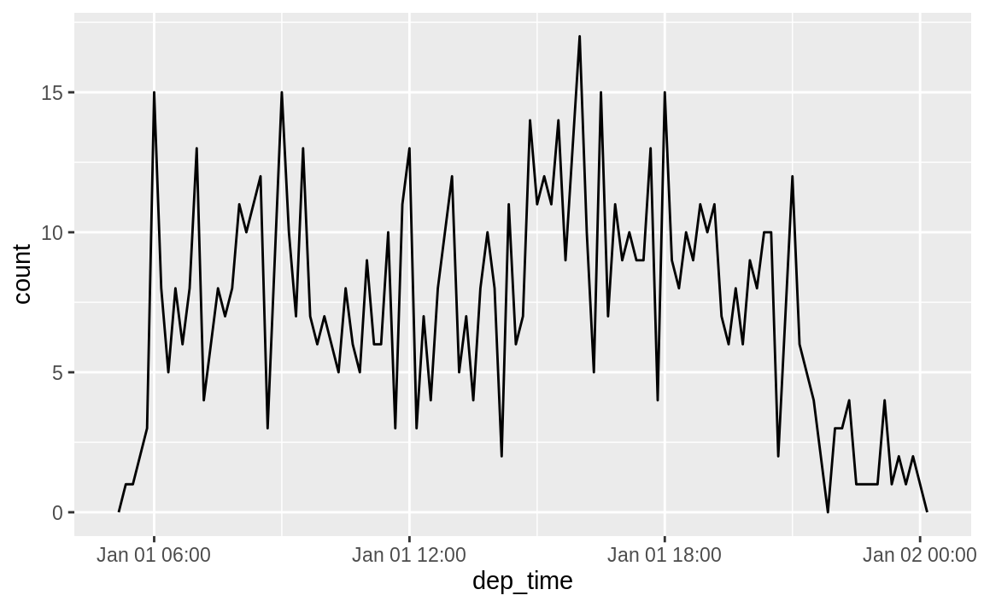
departure times across a single day
flights_dt %>%
filter(dep_time < ymd(20130102)) %>%
ggplot(aes(dep_time)) +
geom_freqpoly(binwidth = 600) # 600 s = 10 minutes
Notes:
Or within a single day:
Note that when you use date-times in a numeric context (like in a histogram), 1 means 1 second, so a binwidth of 86400 means one day. For dates, 1 means 1 day.

Slide 14
From other types
as_datetime() and as_date() can switch between a date-time and a date
as_datetime(today())
#> [1] "2020-01-15 UTC"
as_date(now())
#> [1] "2020-01-15"
date/times as numeric offsets from the “Unix Epoch”
as_datetime(60 * 60 * 10)
#> [1] "1970-01-01 10:00:00 UTC"
as_date(365 * 10 + 2)
#> [1] "1980-01-01"
Notes:
You may want to switch between a date-time and a date. That’s the job of as_datetime() and as_date():
Sometimes you’ll get date/times as numeric offsets from the “Unix Epoch”, 1970-01-01. If the offset is in seconds, use as_datetime(); if it’s in days, use as_date()

Slide 15
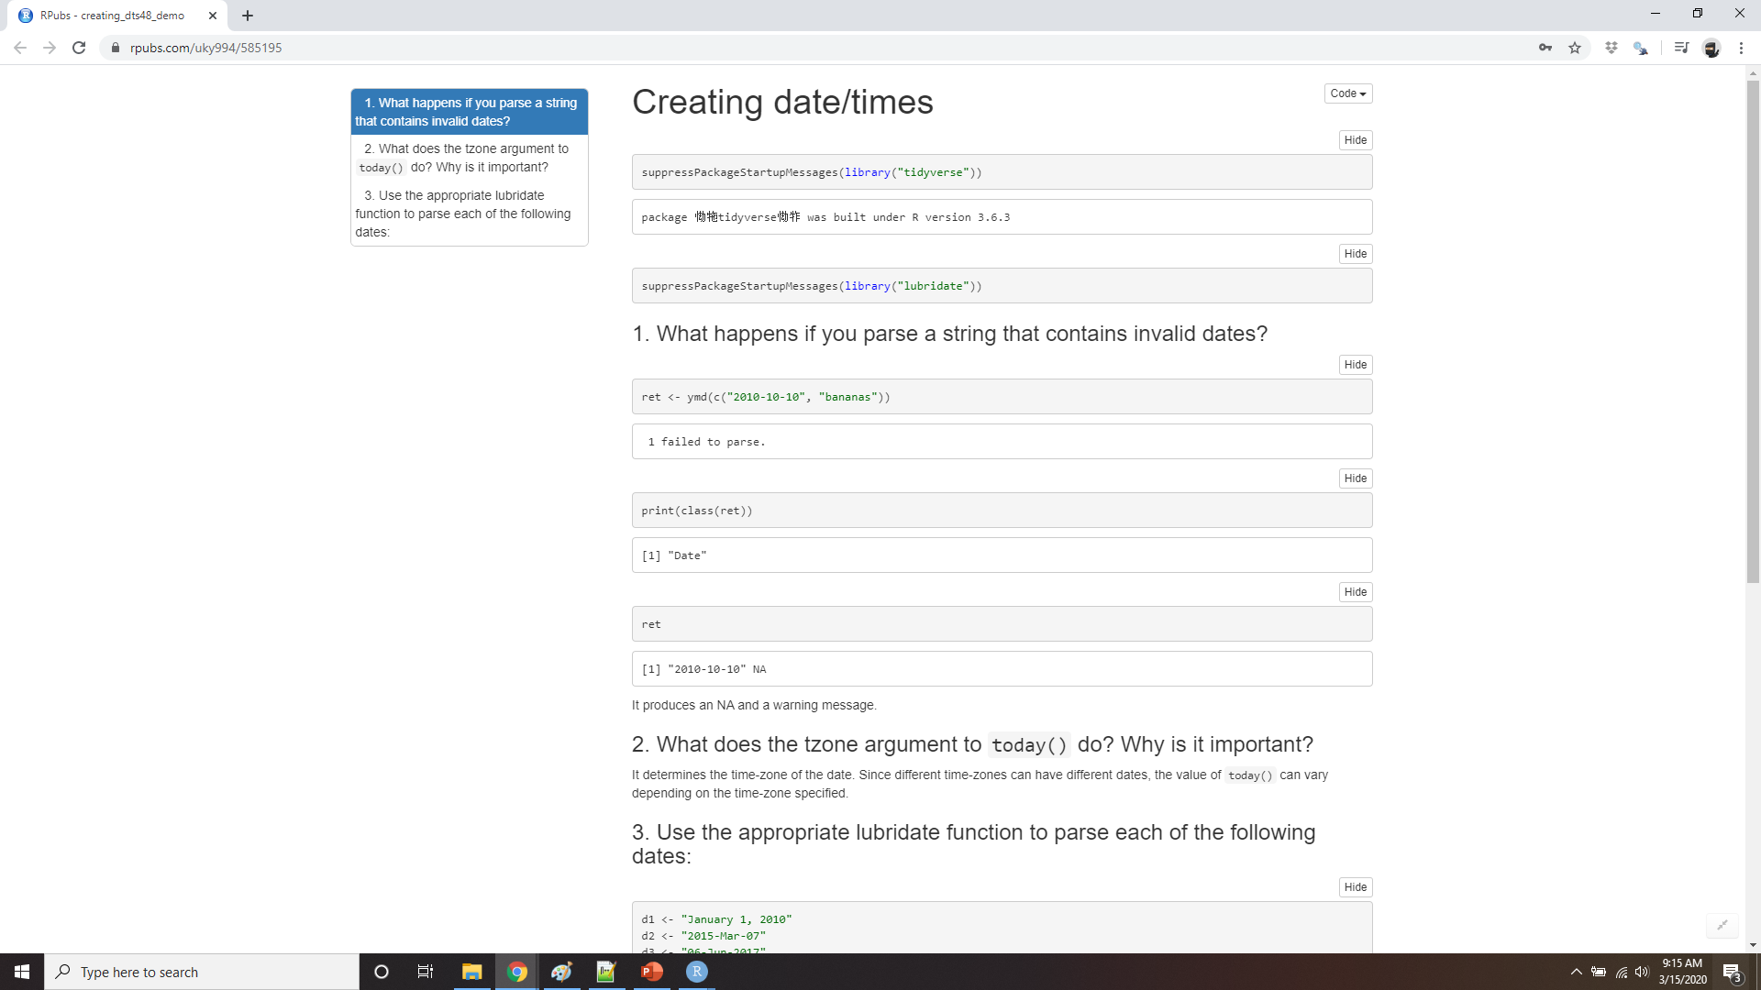
Demo Creating date/times
Notes:
https://rpubs.com/uky994/585195
What happens if you parse a string that contains invalid dates?
ymd(c("2010-10-10", "bananas"))
What does the tzone argument to today() do? Why is it important?
Use the appropriate lubridate function to parse each of the following dates:
d1 <- "January 1, 2010"
d2 <- "2015-Mar-07"
d3 <- "06-Jun-2017"
d4 <- c("August 19 (2015)", "July 1 (2015)")
d5 <- "12/30/14" # Dec 30, 2014

Slide 16
Date-time components
Getting components
datetime <- ymd_hms("2016-07-08 12:34:56")
year(datetime)
#> [1] 2016
month(datetime)
#> [1] 7
mday(datetime)
#> [1] 8
yday(datetime)
#> [1] 190
wday(datetime) #> [1] 6
Notes:
Now that you know how to get date-time data into R’s date-time data structures, let’s explore what you can do with them. This section will focus on the accessor functions that let you get and set individual components. The next section will look at how arithmetic works with date-times.
You can pull out individual parts of the date with the accessor functions year(), month(), mday() (day of the month), yday() (day of the year), wday() (day of the week), hour(), minute(), and second().

Slide 17
Label = true
month(datetime, label = TRUE)
#> [1] Jul
#> 12 Levels: Jan < Feb < Mar < Apr < May < Jun < Jul < Aug < Sep < ... < Dec
wday(datetime, label = TRUE, abbr = FALSE)
#> [1] Friday
#> 7 Levels: Sunday < Monday < Tuesday < Wednesday < Thursday < ... < Saturday
Notes:
For month() and wday() you can set label = TRUE to return the abbreviated name of the month or day of the week. Set abbr = FALSE to return the full name.

Slide 18
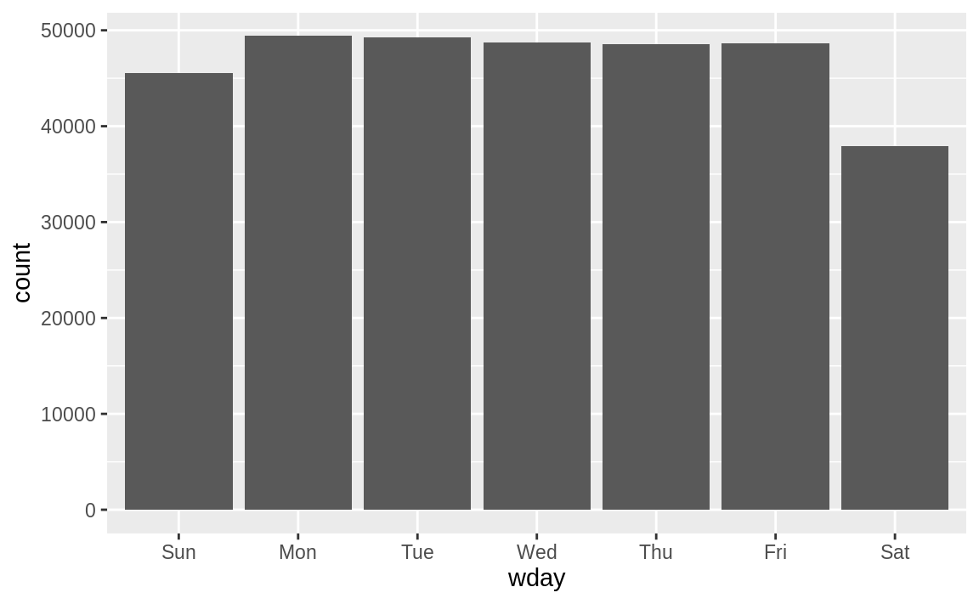
Flights on the weekends
flights_dt %>%
mutate(wday = wday(dep_time, label = TRUE)) %>%
ggplot(aes(x = wday)) +
geom_bar()
Notes:
We can use wday() to see that more flights depart during the week than on the weekend:

Slide 19
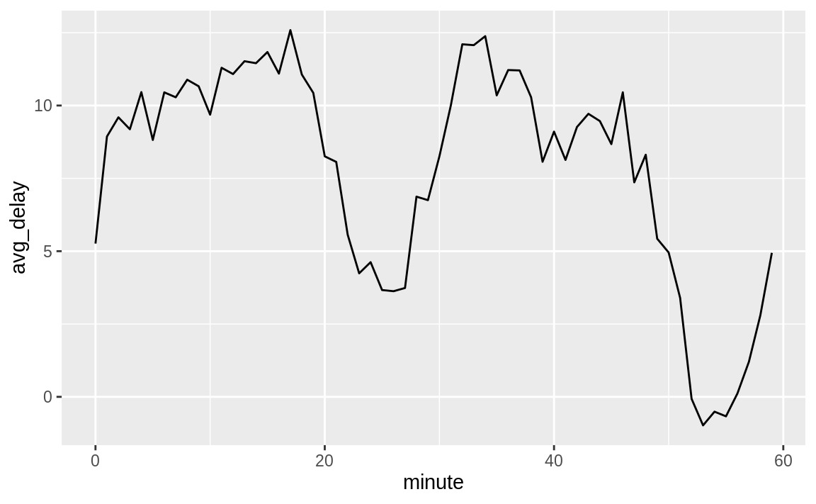
average departure delay by minute
flights_dt %>%
mutate(minute = minute(dep_time)) %>%
group_by(minute) %>%
summarise(
avg_delay = mean(arr_delay, na.rm = TRUE),
n = n()) %>%
ggplot(aes(minute, avg_delay)) +
geom_line()
Notes:
There’s an interesting pattern if we look at the average departure delay by minute within the hour. It looks like flights leaving in minutes 20-30 and 50-60 have much lower delays than the rest of the hour!

Slide 20
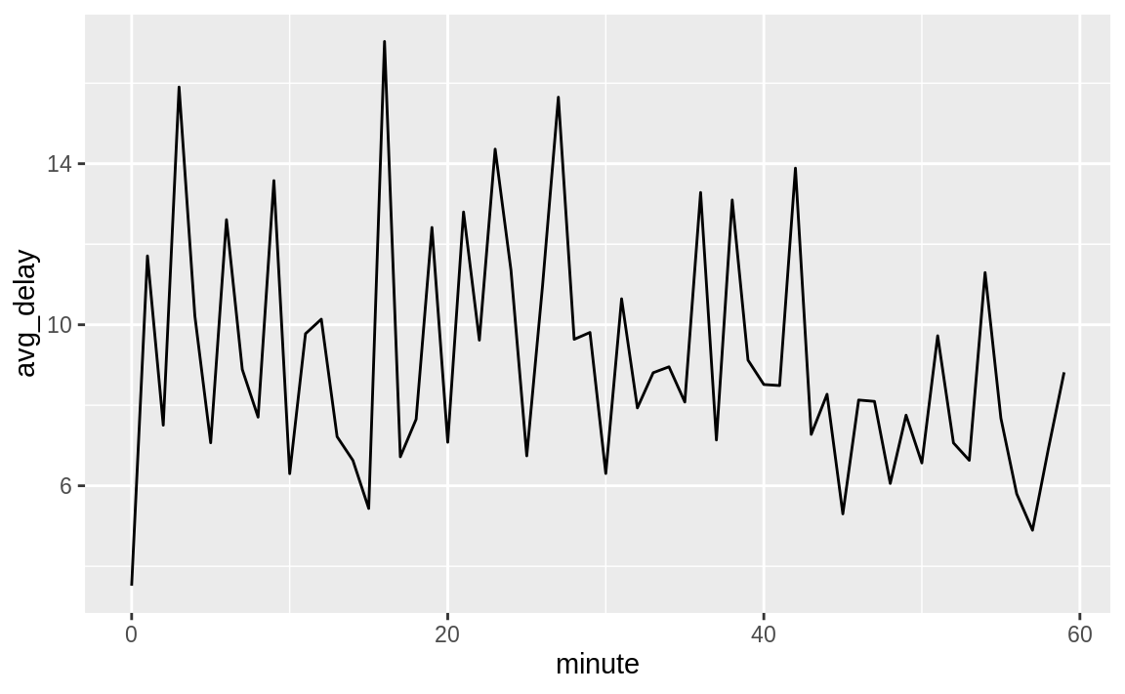
average scheduled departure delay by minute
sched_dep <- flights_dt %>%
mutate(minute = minute(sched_dep_time)) %>%
group_by(minute) %>%
summarise(
avg_delay = mean(arr_delay, na.rm = TRUE),
n = n())
ggplot(sched_dep, aes(minute, avg_delay)) +
geom_line()
Notes:
Interestingly, if we look at the scheduled departure time we don’t see such a strong pattern:

Slide 21
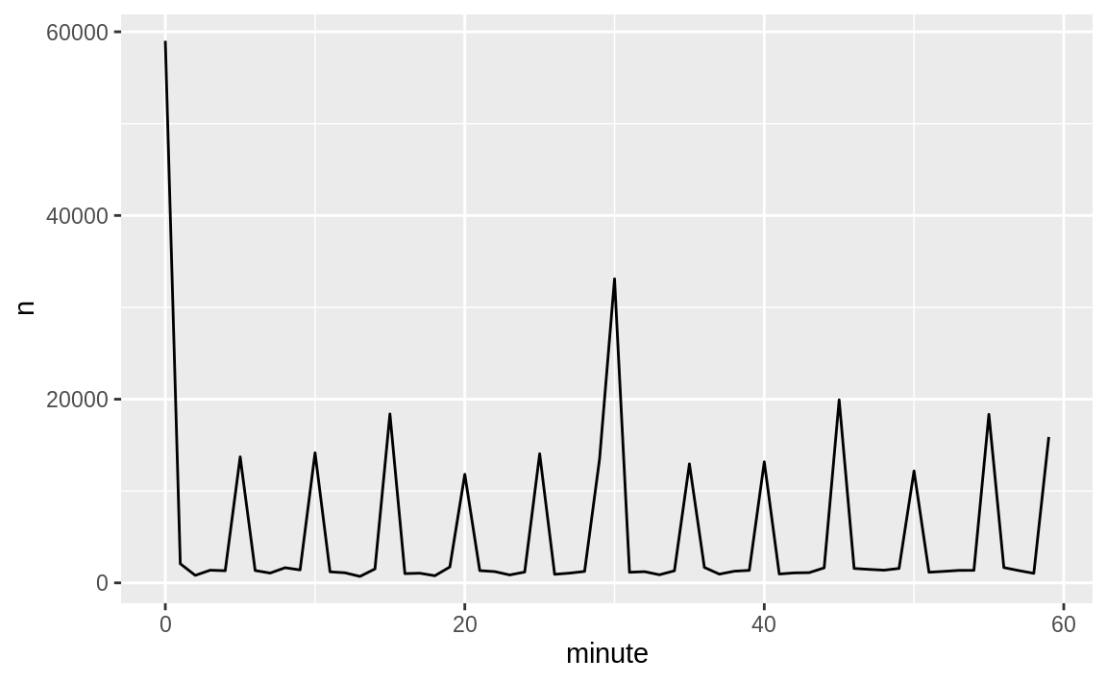
Why?
ggplot(sched_dep, aes(minute, n)) +
geom_line()
Notes:
So why do we see that pattern with the actual departure times? Well, like much data collected by humans, there’s a strong bias towards flights leaving at “nice” departure times. Always be alert for this sort of pattern whenever you work with data that involves human judgement!

Slide 22
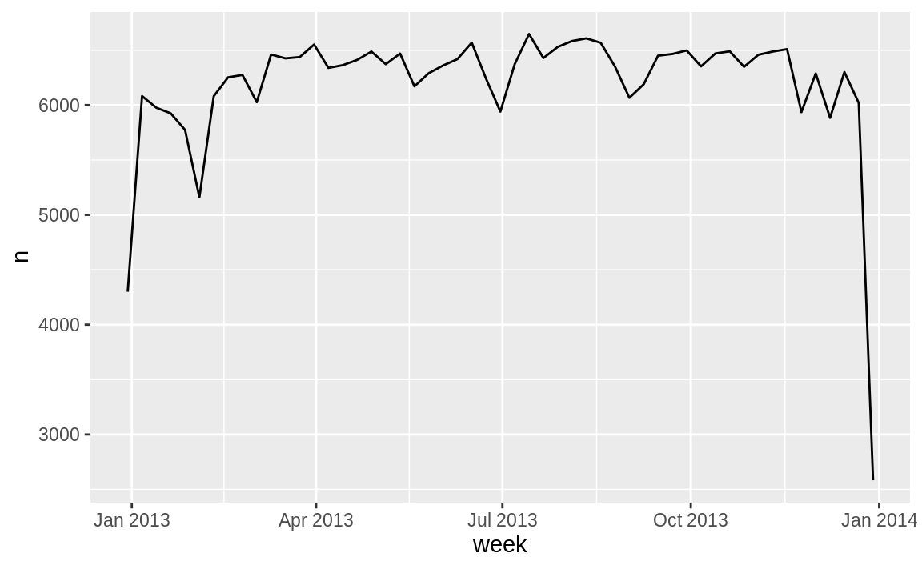
Rounding
flights_dt %>%
count(week = floor_date(dep_time, "week")) %>%
ggplot(aes(week, n)) +
geom_line()
Notes:
An alternative approach to plotting individual components is to round the date to a nearby unit of time, with floor_date(), round_date(), and ceiling_date(). Each function takes a vector of dates to adjust and then the name of the unit round down (floor), round up (ceiling), or round to. This, for example, allows us to plot the number of flights per week:
Computing the difference between a rounded and unrounded date can be particularly useful.

Slide 23
Setting components
(datetime <- ymd_hms("2016-07-08 12:34:56"))
#> [1] "2016-07-08 12:34:56 UTC"
year(datetime) <- 2020
datetime #>
[1] "2020-07-08 12:34:56 UTC"
month(datetime) <- 01
datetime
#> [1] "2020-01-08 12:34:56 UTC"
hour(datetime) <- hour(datetime) + 1
datetime #> [1] "2020-01-08 13:34:56 UTC"
Notes:
You can also use each accessor function to set the components of a date/time:

Slide 24
Update()
update(datetime, year = 2020, month = 2, mday = 2, hour = 2)
#> [1] "2020-02-02 02:34:56 UTC"
ymd("2015-02-01") %>%
update(mday = 30)
#> [1] "2015-03-02"
ymd("2015-02-01") %>%
update(hour = 400)
#> [1] "2015-02-17 16:00:00 UTC"
Notes:
Alternatively, rather than modifying in place, you can create a new date-time with update(). This also allows you to set multiple values at once.
If values are too big, they will roll-over:

Slide 25
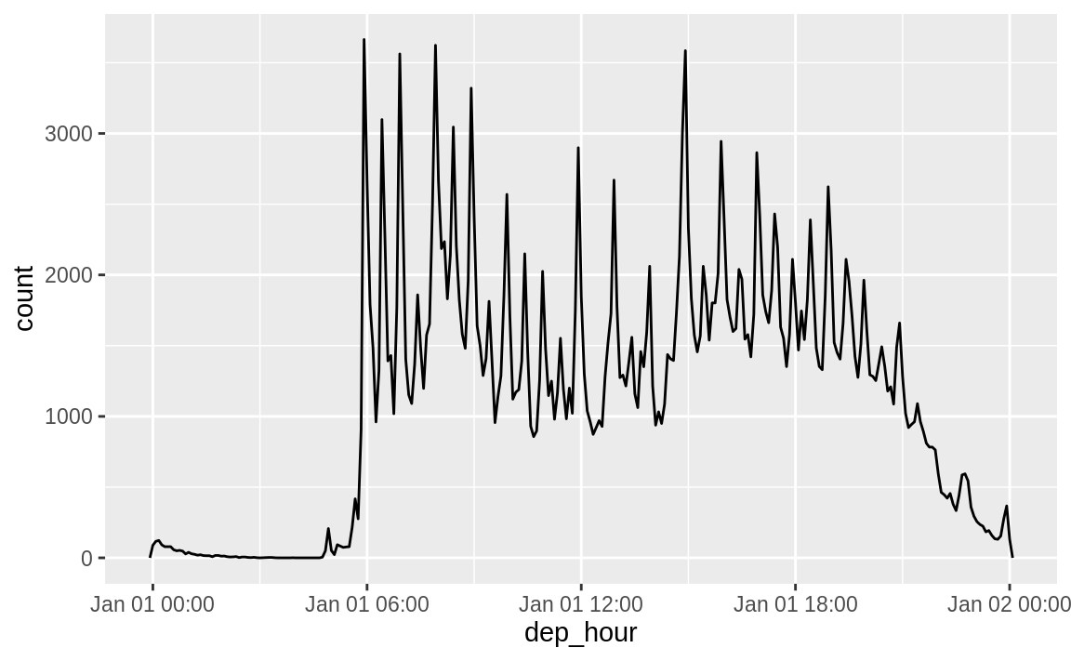
Example: use update to show flights
flights_dt %>%
mutate(dep_hour = update(dep_time, yday = 1)) %>%
ggplot(aes(dep_hour)) +
geom_freqpoly(binwidth = 300)
Notes:
You can use update() to show the distribution of flights across the course of the day for every day of the year:
Setting larger components of a date to a constant is a powerful technique that allows you to explore patterns in the smaller components.

Slide 26
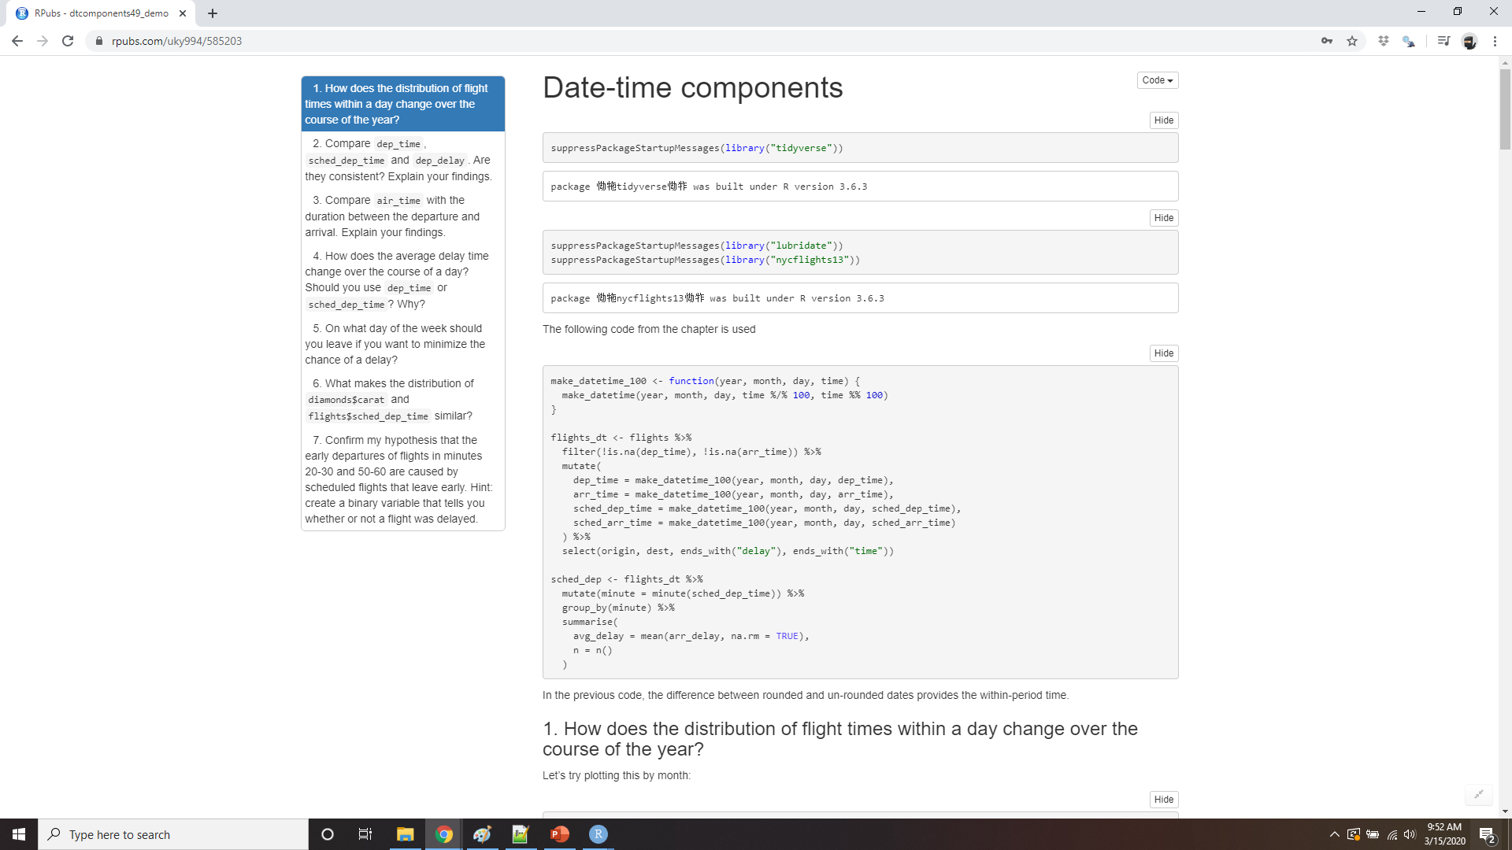
Demo date/time components
Notes:
https://rpubs.com/uky994/585203
How does the distribution of flight times within a day change over the course of the year?
Compare dep_time, sched_dep_time and dep_delay. Are they consistent? Explain your findings.
Compare air_time with the duration between the departure and arrival. Explain your findings. (Hint: consider the location of the airport.)
How does the average delay time change over the course of a day? Should you use dep_time or sched_dep_time? Why?
On what day of the week should you leave if you want to minimise the chance of a delay?
What makes the distribution of diamonds$carat and flights$sched_dep_time similar?
Confirm my hypothesis that the early departures of flights in minutes 20-30 and 50-60 are caused by scheduled flights that leave early. Hint: create a binary variable that tells you whether or not a flight was delayed.

Slide 27
Time spans
durations represent an exact number of seconds.
periods represent human units like weeks and months.
intervals represent a starting and ending point.
Notes:
Next you’ll learn about how arithmetic with dates works, including subtraction, addition, and division. Along the way, you’ll learn about three important classes that represent time spans:
durations, which represent an exact number of seconds.
periods, which represent human units like weeks and months.
intervals, which represent a starting and ending point.

Slide 28
Durations
# How old is Joey?
h_age <- today() - ymd(19820105)
h_age
#> Time difference of 13949 days
as.duration(h_age)
#> [1] "1205193600s (~38.19 years)"
Notes:
In R, when you subtract two dates, you get a difftime object:
A difftime class object records a time span of seconds, minutes, hours, days, or weeks. This ambiguity can make difftimes a little painful to work with, so lubridate provides an alternative which always uses seconds: the duration.

Slide 29
Duration helpers
dseconds(15)
#> [1] "15s"
dminutes(10)
#> [1] "600s (~10 minutes)"
dhours(c(12, 24))
#> [1] "43200s (~12 hours)" "86400s (~1 days)"
ddays(0:5)
#> [1] "0s" "86400s (~1 days)" "172800s (~2 days)"
#> [4] "259200s (~3 days)" "345600s (~4 days)" "432000s (~5 days)"
dweeks(3)
#> [1] "1814400s (~3 weeks)"
dyears(1)
#> [1] "31536000s (~52.14 weeks)"
Notes:
Durations come with a bunch of convenient constructors
Durations always record the time span in seconds. Larger units are created by converting minutes, hours, days, weeks, and years to seconds at the standard rate (60 seconds in a minute, 60 minutes in an hour, 24 hours in day, 7 days in a week, 365 days in a year).

Slide 30
Mathematical operations on durations
2 * dyears(1)
#> [1] "63072000s (~2 years)"
dyears(1) + dweeks(12) + dhours(15)
#> [1] "38847600s (~1.23 years)"
tomorrow <- today() + ddays(1)
last_year <- today() - dyears(1)
Notes:
You can add and multiply durations:
You can add and subtract durations to and from days:

Slide 31
careful
one_pm <- ymd_hms("2016-03-12 13:00:00", tz = "America/New_York")
one_pm
#> [1] "2016-03-12 13:00:00 EST"
one_pm + ddays(1)
#> [1] "2016-03-13 14:00:00 EDT"
Notes:
However, because durations represent an exact number of seconds, sometimes you might get an unexpected result:
Why is one day after 1pm on March 12, 2pm on March 13?! If you look carefully at the date you might also notice that the time zones have changed. Because of DST, March 12 only has 23 hours, so if we add a full days worth of seconds we end up with a different time.

Slide 32
Periods
one_pm #> [1] "2016-03-12 13:00:00 EST"
one_pm + days(1)
#> [1] "2016-03-13 13:00:00 EDT"
Notes:
To solve this problem, lubridate provides periods. Periods are time spans but don’t have a fixed length in seconds, instead they work with “human” times, like days and months. That allows them work in a more intuitive way:

Slide 33
Period helper functions
seconds(15)
#> [1] "15S"
minutes(10)
#> [1] "10M 0S"
hours(c(12, 24))
#> [1] "12H 0M 0S" "24H 0M 0S"
days(7)
#> [1] "7d 0H 0M 0S"
months(1:6)
#> [1] "1m 0d 0H 0M 0S" "2m 0d 0H 0M 0S" "3m 0d 0H 0M 0S" "4m 0d 0H 0M 0S"
#> [5] "5m 0d 0H 0M 0S" "6m 0d 0H 0M 0S"
weeks(3)
#> [1] "21d 0H 0M 0S"
years(1)
#> [1] "1y 0m 0d 0H 0M 0S"
Notes:
Like durations, periods can be created with a number of friendly constructor functions.

Slide 34
Mathematical operations on periods
10 * (months(6) + days(1))
#> [1] "60m 10d 0H 0M 0S"
days(50) + hours(25) + minutes(2)
#> [1] "50d 25H 2M 0S"
# A leap year
ymd("2016-01-01") + dyears(1)
#> [1] "2016-12-31"
ymd("2016-01-01") + years(1)
#> [1] "2017-01-01"
# Daylight Savings Time
one_pm + ddays(1)
#> [1] "2016-03-13 14:00:00 EDT"
one_pm + days(1)
#> [1] "2016-03-13 13:00:00 EDT"
Notes:
You can add and multiply periods:
And of course, add them to dates. Compared to durations, periods are more likely to do what you expect:

Slide 35
planes arrive before they departed?
flights_dt %>%
filter(arr_time < dep_time)
#> # A tibble: 10,633 x 9
#> origin dest dep_delay arr_delay dep_time sched_dep_time
#> <chr> <chr> <dbl> <dbl> <dttm> <dttm>
#> 1 EWR BQN 9 -4 2013-01-01 19:29:00 2013-01-01 19:20:00
#> 2 JFK DFW 59 NA 2013-01-01 19:39:00 2013-01-01 18:40:00
#> 3 EWR TPA -2 9 2013-01-01 20:58:00 2013-01-01 21:00:00
#> 4 EWR SJU -6 -12 2013-01-01 21:02:00 2013-01-01 21:08:00
#> 5 EWR SFO 11 -14 2013-01-01 21:08:00 2013-01-01 20:57:00
#> 6 LGA FLL -10 -2 2013-01-01 21:20:00 2013-01-01 21:30:00
#> # … with 1.063e+04 more rows, and 3 more variables: arr_time <dttm>,
#> # sched_arr_time <dttm>, air_time <dbl>
Notes:
Let’s use periods to fix an oddity related to our flight dates. Some planes appear to have arrived at their destination before they departed from New York City.

Slide 36
planes arrive before they departed?
flights_dt <- flights_dt %>%
mutate(
overnight = arr_time < dep_time,
arr_time = arr_time + days(overnight * 1),
sched_arr_time = sched_arr_time + days(overnight * 1)
)
flights_dt %>%
filter(overnight, arr_time < dep_time)
#> # A tibble: 0 x 10
#> # … with 10 variables: origin <chr>, dest <chr>, dep_delay <dbl>,
#> # arr_delay <dbl>, dep_time <dttm>, sched_dep_time <dttm>, arr_time <dttm>,
#> # sched_arr_time <dttm>, air_time <dbl>, overnight <lgl>
Notes:
These are overnight flights. We used the same date information for both the departure and the arrival times, but these flights arrived on the following day. We can fix this by adding days(1) to the arrival time of each overnight flight.
Now all of our flights obey the laws of physics.

Slide 37
Intervals
years(1) / days(1)
#> estimate only: convert to intervals for accuracy
#> [1] 365
Notes:
It’s obvious what dyears(1) / ddays(365) should return: one, because durations are always represented by a number of seconds, and a duration of a year is defined as 365 days worth of seconds.
What should years(1) / days(1) return? Well, if the year was 2015 it should return 365, but if it was 2016, it should return 366! There’s not quite enough information for lubridate to give a single clear answer. What it does instead is give an estimate, with a warning:

Slide 38
intervals
next_year <- today() + years(1)
(today() %--% next_year) / ddays(1)
#> [1] 366
(today() %--% next_year) %/% days(1)
#> Note: method with signature 'Timespan#Timespan' chosen for function '%/%’,
#> target signature 'Interval#Period’.
#> "Interval#ANY", "ANY#Period" would also be valid
#> [1] 366
Notes:
If you want a more accurate measurement, you’ll have to use an interval. An interval is a duration with a starting point: that makes it precise so you can determine exactly how long it is:
To find out how many periods fall into an interval, you need to use integer division:

Slide 39
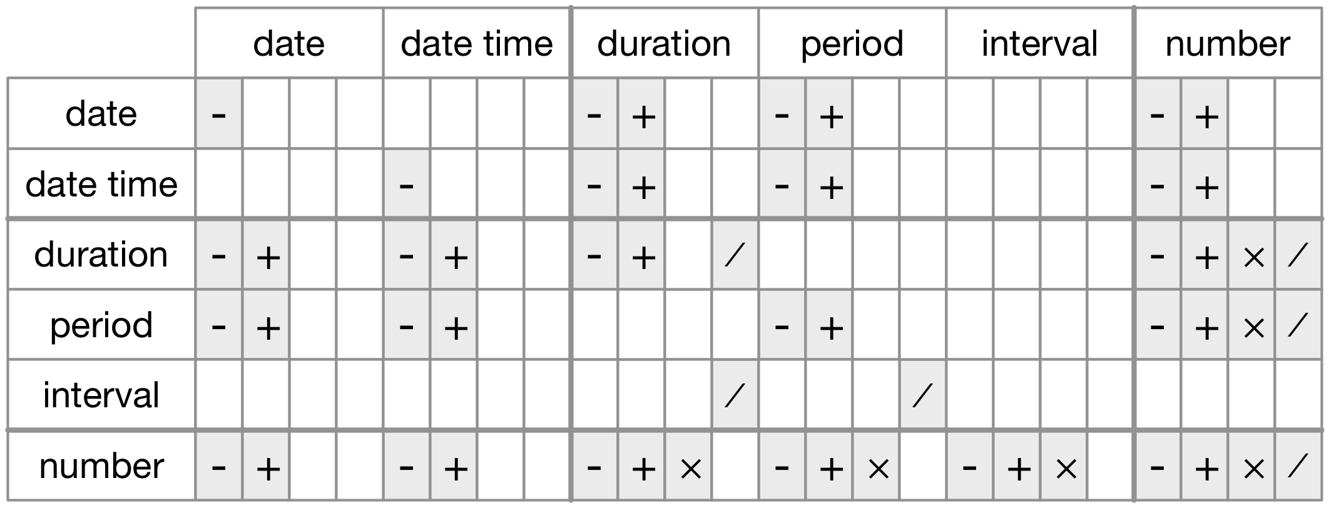
Summary
The allowed arithmetic operations between pairs of date/time classes.
Notes:
How do you pick between duration, periods, and intervals? As always, pick the simplest data structure that solves your problem. If you only care about physical time, use a duration; if you need to add human times, use a period; if you need to figure out how long a span is in human units, use an interval.
Figure 16.1 summarises permitted arithmetic operations between the different data types.
Figure: The allowed arithmetic operations between pairs of date/time classes.

Slide 40
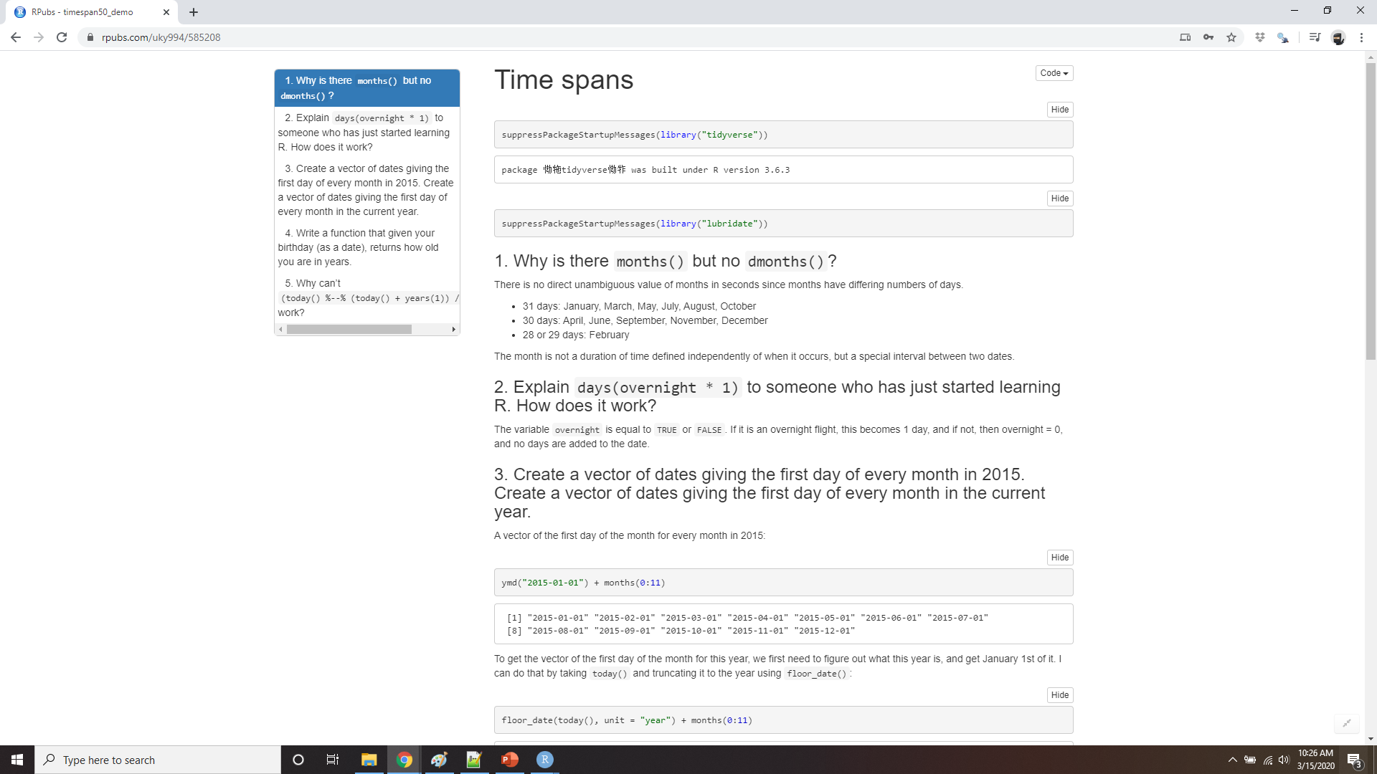
Demo time spans
Notes:
https://rpubs.com/uky994/585208
Why is there months() but no dmonths()?
Explain days(overnight * 1) to someone who has just started learning R. How does it work?
Create a vector of dates giving the first day of every month in 2015. Create a vector of dates giving the first day of every month in the current year.
Write a function that given your birthday (as a date), returns how old you are in years.
Why can’t (today() %--% (today() + years(1))) / months(1) work?

Slide 41
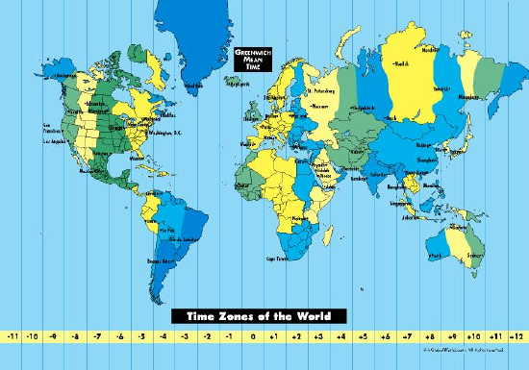
Time zones
http://www.iana.org/time-zones
Notes:
Time zones are an enormously complicated topic because of their interaction with geopolitical entities. Fortunately we don’t need to dig into all the details as they’re not all important for data analysis, but there are a few challenges we’ll need to tackle head on.
The first challenge is that everyday names of time zones tend to be ambiguous. For example, if you’re American you’re probably familiar with EST, or Eastern Standard Time. However, both Australia and Canada also have EST! To avoid confusion, R uses the international standard IANA time zones. These use a consistent naming scheme “/”, typically in the form “<continent>/<city>” (there are a few exceptions because not every country lies on a continent). Examples include “America/New_York”, “Europe/Paris”, and “Pacific/Auckland”.
You might wonder why the time zone uses a city, when typically you think of time zones as associated with a country or region within a country. This is because the IANA database has to record decades worth of time zone rules. In the course of decades, countries change names (or break apart) fairly frequently, but city names tend to stay the same. Another problem is that name needs to reflect not only to the current behaviour, but also the complete history. For example, there are time zones for both “America/New_York” and “America/Detroit”. These cities both currently use Eastern Standard Time but in 1969-1972 Michigan (the state in which Detroit is located), did not follow DST, so it needs a different name. It’s worth reading the raw time zone database (available at http://www.iana.org/time-zones) just to read some of these stories!

Slide 42
Sys.timezone()
Sys.timezone()
#> [1] "UTC"
length(OlsonNames())
#> [1] 607
head(OlsonNames())
#> [1] "Africa/Abidjan" "Africa/Accra" "Africa/Addis_Ababa"
#> [4] "Africa/Algiers" "Africa/Asmara" "Africa/Asmera"
Notes:
You can find out what R thinks your current time zone is with Sys.timezone()
(If R doesn’t know, you’ll get an NA.)
And see the complete list of all time zone names with OlsonNames():

Slide 43
Tz controls printing
(x1 <- ymd_hms("2020-06-01 12:00:00", tz = "America/New_York"))
#> [1] "2015-06-01 12:00:00 EDT"
(x2 <- ymd_hms("2020-06-01 18:00:00", tz = "Europe/Copenhagen"))
#> [1] "2015-06-01 18:00:00 CEST"
(x3 <- ymd_hms("2020-06-02 04:00:00", tz = "Pacific/Auckland"))
#> [1] "2015-06-02 04:00:00 NZST"
x1 - x2
#> Time difference of 0 secs
x1 - x3
#> Time difference of 0 secs
Notes:
In R, the time zone is an attribute of the date-time that only controls printing. For example, these three objects represent the same instant in time:
You can verify that they’re the same time using subtraction:

Slide 44
UTC (Coordinated Universal Time)
x4 <- c(x1, x2, x3) x4
#> [1] "2020-06-01 12:00:00 CST" "2020-06-01 12:00:00 CST"
#> [3] "2020-06-01 12:00:00 CST "
Notes:
Unless otherwise specified, lubridate always uses UTC. UTC (Coordinated Universal Time) is the standard time zone used by the scientific community and roughly equivalent to its predecessor GMT (Greenwich Mean Time). It does not have DST, which makes a convenient representation for computation. Operations that combine date-times, like c(), will often drop the time zone. In that case, the date-times will display in your local time zone:

Slide 45
change the time zone
Keep the instant in time the same, and change how it’s displayed.
x4a <- with_tz(x4, tzone = "Australia/Lord_Howe")
x4a
#> [1] "2015-06-02 02:30:00 +1030" "2015-06-02 02:30:00 +1030"
#> [3] "2015-06-02 02:30:00 +1030"
x4a - x4
#> Time differences in secs #> [1] 0 0 0
Notes:
You can change the time zone in two ways:
Keep the instant in time the same, and change how it’s displayed. Use this when the instant is correct, but you want a more natural display.
(This also illustrates another challenge of times zones: they’re not all integer hour offsets!)

Slide 46
change the time zone
Change the underlying instant in time
x4b <- force_tz(x4, tzone = "Australia/Lord_Howe")
x4b
#> [1] "2015-06-01 12:00:00 +1030" "2015-06-01 12:00:00 +1030"
#> [3] "2015-06-01 12:00:00 +1030"
x4b - x4
#> Time differences in hours
#> [1] -14.5 -14.5 -14.5
Notes:
Change the underlying instant in time. Use this when you have an instant that has been labelled with the incorrect time zone, and you need to fix it.

